Slide 1
Implementation of the Community Hydrologic Prediction System
David R. Vallee
Hydrologist-in-Charge
NOAA/NWS Northeast River Forecast Center
Eastern Region Flash Flood Conference
Notes:
1

Slide 2
Topics
Background
What is CHPS?
Hydrology community benefits
Project Organization
Risk reduction forecast offices
Transition challenges
Operations benefits
Notes:
2

Slide 3
Background
Today’s NWS River Forecast System (NWSRFS) has been the NWS hydrologic forecasting foundation for over 30 years
NWSRFS architecture hinders use of recent advances in interactive forecasting and modeling
NWS needs an improved hydrologic modeling infrastructure to leverage community operational concepts and models as well as provide future products and services
The Community Hydrologic Prediction System (CHPS) will replace NWSRFS
For more information, see the NWS OHD CHPS web site (http://www.nws.noaa.gov/ohd/hrl/chps/index.html)
Notes:
3

Slide 4
What is CHPS?
CHPS is both a system and a concept
  Open forecasting system to promote model & data sharing
  NOAA reaching out to hydro community
CHPS uses Delft-FEWS from Deltares (Dutch Foundation) as core infrastructure
  FEWS: Flood Early Warning System
  Model adapter concept for algorithm modularity
  Sophisticated data and workflow handling for models
  Comprehensive forecaster user interface and displays (the IFD)
  Highly configurable modeling environment via XML files
Initially, includes NWSRFS models and USACE models (HEC-RAS and HEC-ResSim)
Later, can include models from other providers
Notes:
4

Slide 5


CHPS and FEWS
FC
FEWS Models
CHPS
Models from Federal, State, Local, University and international researchers
FEWS
Other Models
NWS Models
USACE Models
Notes:
5

Slide 6
FEWS Development – Past 10 Years
First FEWS system: 1992 in Sudan
  Blue Nile, Atbara & White Nile
  Used Sacramento Rainfall-Runoff, HD routing & Reservoir models
1997/1998 more flexible FEWS system deployed in Pakistan & Czech Republic
1999 European Flood Forecasting System (EFFS) was developed
  Modernize flood forecasting capabilities
  Birth of the Java style FEWS
  Also became the operational system in Switzerland & the Netherlands
2002 Environment Agency, UK adopted FEWS as its Forecasting System
  Birth of FEWS 2.0 – configured as a client-server system
Notes:
6

Slide 7
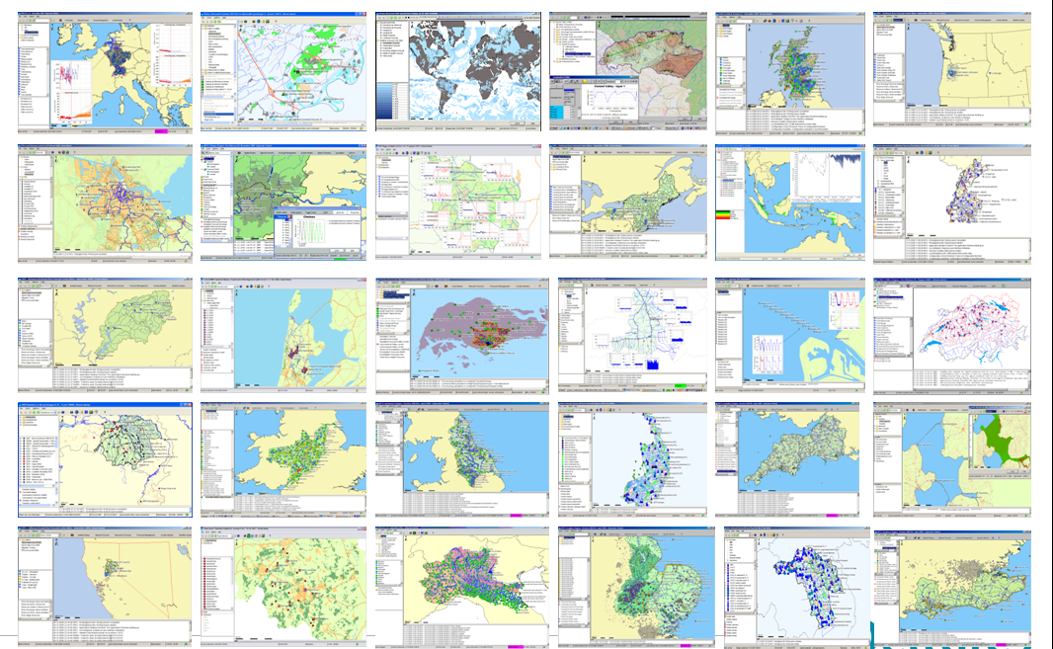
Global User Community
7
Notes:
5/21/2010
7
Europe...
* National Flood Forecasting System (NFFS) - Environment Agency for England & Wales
* National Groundwater Modeling System (NGMS) - National architecture for running and managing groundwater models - Environment Agency for England & Wales
* FEWS Scotland - Scottish Environmental Protection Agency (SEPA)
* Flood and Drought Forecasting System for Po River (Italy) - ARPA
* FEWS NL - River flood forecasting system for Rhine and Meuse - Ministry of Public Works and Water Resources, The Netherlands
* FEWS Lakes - Forecasting system for central lake in The Netherlands - Ministry of Public Works and Water Resources, The Netherlands
* Several applications for Dutch Water boards (e.g. Reggie & Dinked, Hollandse Delta, Aa en Maas, Peel en Maasvallei, Stichtse Rijnlanden, Waternet, Roer en Overmaas)
* FEWS Algae Bloom - Forecasting of harmful algae bloom in Dutch coastal waters - Ministry of Public Works and Water Resources, The Netherlands (experimental application)
* FEWS Austria - Forecasting for the Danube River and its branches - Provincial Governments of Lower Austria, Upper Austria and Salzburg
* FEWS Switzerland - Forecasting for Rhine River branches in Switzerland - Federal Office for the Environment
* FEWS Rhine for Germany - Flow forecasting for Rhine River in Germany - Federal Institute of Hydrology, Germany
* FEWS Segura River - Segura River Basin Confederation in Spain (in progress)
* FEWS World - Worldwide hydrological forecasting using freely available data (research application at Deltares)
North America..
* Community Hydrologic Prediction System (CHPS) - National Weather Service (NWS) (in progress)
* FEWS New Brunswick - Government of New Brunswick, Canada (early stages; definition study starts in Dec '08)
Asia...
* National Flood and Drought Forecasting System for Taiwan - Ministry of Water Resources
* FEWS Mekong - Mekong River Commission (MRC)
* Water Quality Forecasting System for Marina Reservoir - Public Utilities Board (in progress)
* FEWS Songhkla & FEWS Moon River - Flow forecasting applications in Thailand
(Mae Nam Mun and Chi river basin in Thailand)
* FEWS Pakistan - Flood forecasting for Indus River
* FEWS Sistan - Flow forecasting for Sistan River in Eastern Iran
Australia...
* FEWS Australia - Bureau of Meteorology (early stages; first pilots planned for 2009)National Flood Forecasting System (NFFS) in England and Wales for U.K. Environment Agency

Slide 8
The NWS Path to FEWS
8
2003: OHD initiated exploration of a replacement for NWSRFS
2005: Several candidates considered – including Delft-FEWS
2006: ABRFC, NCRFC, NWRFC and CNRFC volunteered to work with OHD to evaluate candidates
  (CHPS Acceleration Team or CAT)
2007: Selected Delft-FEWS as the candidate for CHPS
2008: Gary Carter approved decision; proceed with implementation of Delft-FEWS as the CHPS software infrastructure
  NERFC brought on board to replace NCRFC as a CAT member
  NOHRSC added as well
  NWSEO brought on board to help develop path toward operational testing, evaluation and impact and implementation
Notes:
8

Slide 9
Hydrology Community Benefits
Key motivation for community is to broaden and accelerate research to operations
  Meteorological example: The Weather Research and Forecasting (WRF) Model (http://www.wrf-model.org/index.php)
  Enhance understanding of hydrologic forecasting within hydrologic research community
Hydrology community includes
  NOAA line offices
  other U.S. Federal agencies (e.g., USACE, USGS, USBR)
  U.S. Universities (e.g., http://www.cuahsi.org/)
  International researchers
NWS to make CHPS and hydro models available
Notes:
CUAHSI = Consortium of Universities for the Advancement of Hydrologic Science, Inc.
9

Slide 10
Risk Reduction River Forecast Offices
10
Goal to create and validate transition path for 9 follow-on RFCs based on CAT RFCs’ experiences with one year lead in schedule
Support for follow-on 9 RFCs from the 4 risk reduction RFCs
  Each CAT RFC to assist 2 – 3 “buddies”
  “Buddy” visits were conducted in March through July of 2010
  Migration activities at these 9 RFCs are in progress
Also key to risk reduction was establishment of a clear set of “Baseline” Operational Capabilities to avoid requirements creep
CAT RFCs have moved into some degree of parallel execution with NWSRFS
Notes:
10

Slide 11
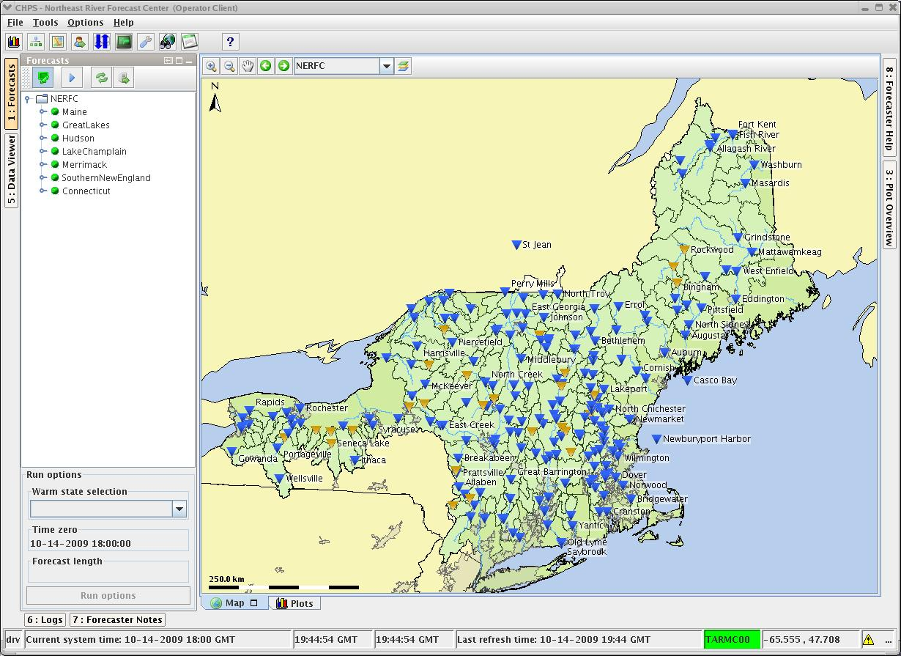
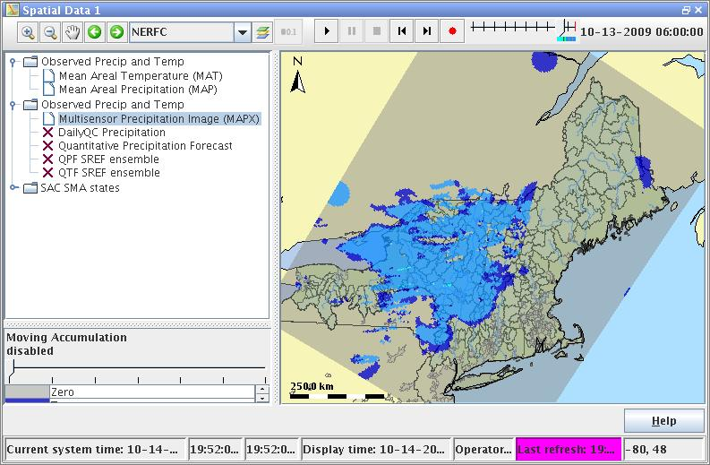
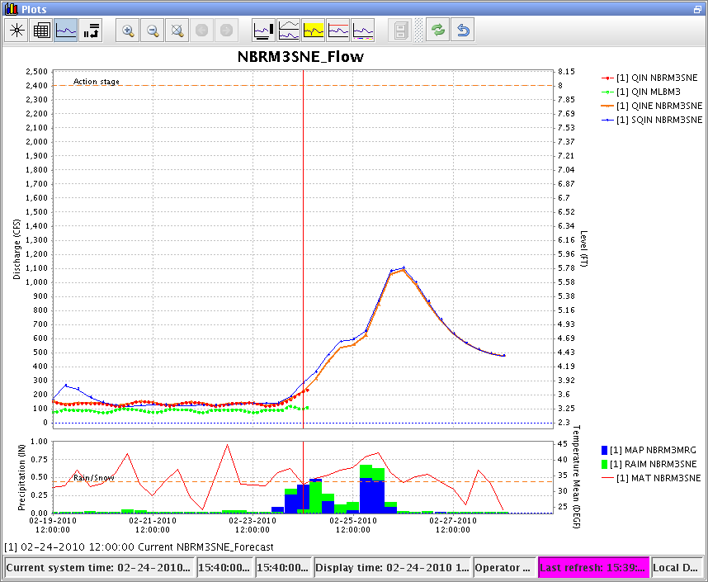
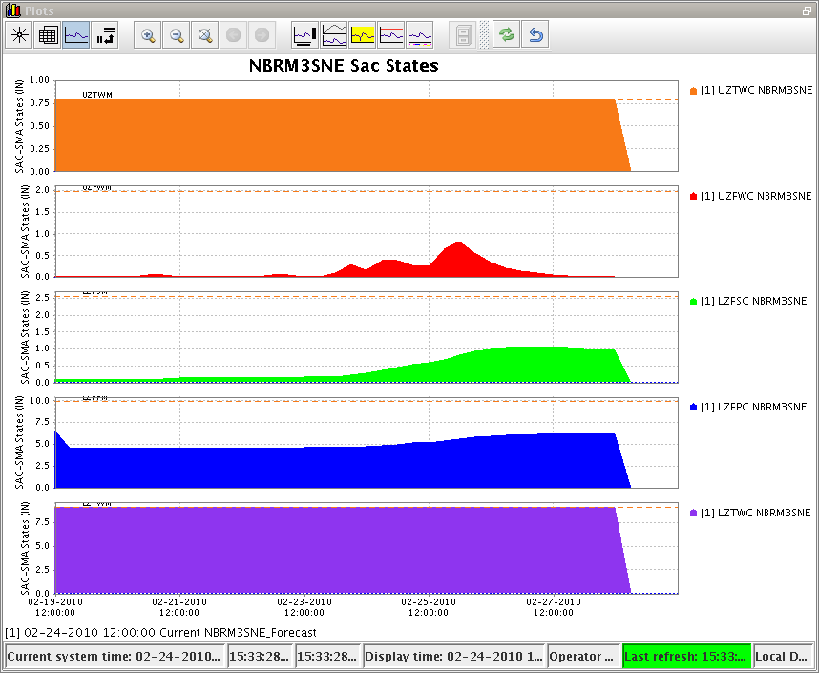
The CHPS Interactive Forecaster Display
11
Notes:
5/21/2010
11
11

Slide 12
Transition Challenges
Challenges are technical
  Must not disrupt daily forecasting
  Must assure hydro models perform the same within new infrastructure
  Must assure model performance not degraded while taking opportunity to move to gridded meteorological forcings
Challenges are cultural
  NWS forecasters require training
  NWS researchers and programmers need to re-orient to highly configurable environment
Field support requires new paradigm that includes support of external models
Operating in a truly community oriented environment within the U.S. and abroad
Notes:
12

Slide 13
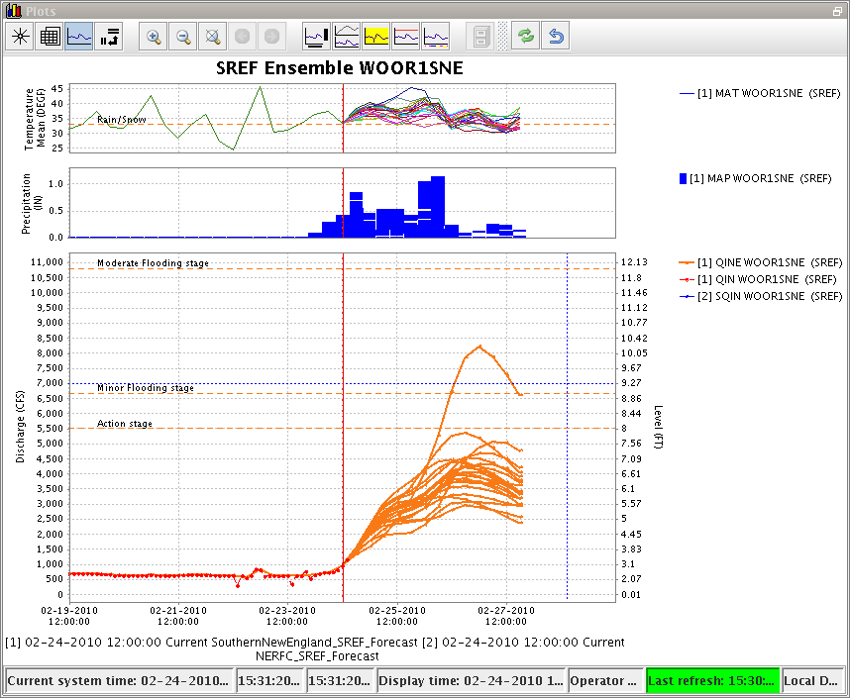
Operations Benefits
More flexibility to address upcoming major service enhancements
  Short term ensemble forecasts
  Gridded hydrologic modeling
  Gridded water resources forecasts
Simpler and accelerated research to operations path
Take advantage of community-developed models
Simpler and lower cost of software maintenance and addition of small enhancements
  NWS developers concentrate on hydrology not infrastructure
Notes:
13

Slide 14
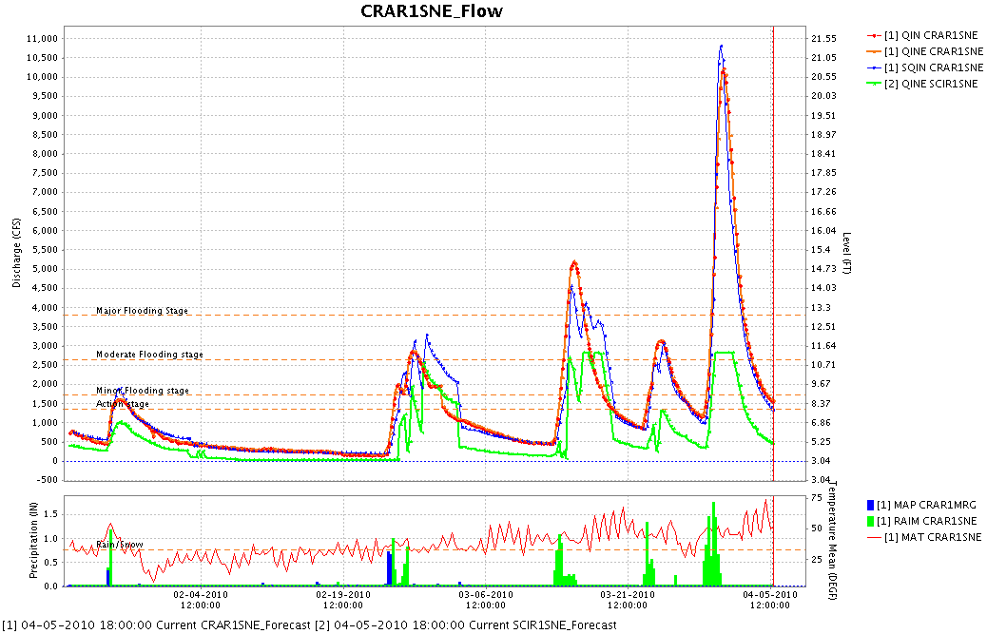
WFO Benefits
More efficient and timely delivery of forecasts
With the infusion of new science and modeling – improved forecasts for short/long range
Collaborative hydrologic/hydraulic modeling activities
  Site Specific
  International Partners – New Brunswick, Canada, NERFC and WFO Caribou, ME
Potential for a CHPS Client to reside at the WFO
Improved collaboration between RFCs and WFOs
Notes:
14

Slide 15
Implementation of the Community Hydrologic Prediction System
Questions????
David R. Vallee
Hydrologist-in-Charge
NOAA/NWS Northeast River Forecast Center
Eastern Region Flash Flood Conference
Notes:
19 January 2010
7B.3, Introduction of NOAA's CHPS
15
15

Slide 16
Backup Slides
16
Notes:
16

Slide 17
Models in FEWS
Model | Type | Supplier/Owner | Country
ISIS | Hydrodynamics | HR/Halcrow | UK
PDM | Rainfall-Runoff | CEH | UK
TCM | Rainfall-Runoff | CEH | UK
KW | Routing (kinematic wave) | CEH | UK
PACK | Snow Melt | CEH | UK
ARMA | Error Correction | CEH | UK
PRTF | Event Based RR | PlanB | UK
TRITON | Surge propagation/Overtopping | PlanB | UK
STF | Transfer functions | EA | UK
DODO | Routing (layered Muskingum) | EA | UK
MCRM | Rainfall-Runoff | EA | UK
Modflow96/VKD | 3D groundwater | Deltares/Adam Taylor | Netherlands/UK
Mike11 | Hydrodynamics | DHI | Denmark
NAM | Rainfall-Runoff | DHI | Denmark
LISFLOOD | Distributed Rainfall-Runoff | JRC | Italy
TOPKAPI | Rainfall-Runoff | Univ. of Bologna | Italy
HBV | Rainfall-Runoff (inc snowmelt) | SHMI | Sweden
Vflo | Distributed Rainfall-Runoff | Vieux & Assiciates | USA
SWMM | Urban Rainfall-Runoff | USGS | USA
HEC-RAS | Hydrodynamics | USACE | USA
Snow17 | Snow Melt | NWS | USA
SACSMA | Rainfall-Runoff | NWS | USA
Unit-H | Unit-Hydrograph | NWS | USA
PRMS | Rainfall-Runoff | Univ. of Karlsruhre | Germany
SynHP | Hydrodynamics | BfG | Germany
SOBEK | Hydrodynamics, Water Quality, RR | Deltares | Netherlands
SOBEK-2d | Linked 1d/2d inundation modelling | Deltares | Netherlands
Sacramento | Rainfall-Runoff | Deltares | Netherlands
RIBASIM | Water distribution + Reservoir | Deltares | Netherlands
REW | Distributed Rainfall-Runoff | Deltares | Netherlands
DELFT3D | 2/3D Hydrodynamics/ Water quality | Deltares | Netherlands
TWAM | 2D Hydrodynamics | PlanB | UK
17
Notes:
5/21/2010
17

